Slide 1

Group one

Slide 2

CONTENTS
Plague Flood
The Rat Clip
Rat Poison
Two-pronged

Slide 3
CONTENTS
Plague Flood
The Rat Clip
Rat Poison
Two-pronged

Slide 4

Background
What is credit card swiping?
credit card swiping refers to the illegal or criminal act of copying other's credit card with various illegal forms to steal the cardholder's funds. In reality, the main situation is that the cardholder does not lose the credit card, and the payment password is not informed to others, but the funds are consumed by a completely unknown third party.
Motivation
In recent years, the cases of credit card swiping occur frequently, which seriously damages the legitimate rights and interests of cardholders. This project hopes to use a set of credit card consumption data sets to train a classifier to distinguish whether the user's credit card use record is fraudulent information, so that the credit card company can identify fraudulent credit card transactions.
Description of data
The data set contains the European cardholder's credit card transaction data for September 2013. This dataset shows transactions that took place in two days and includes 284807 transactions, of which 492 were credit swiping cases.
Selection of algorithm
the data set contains many dimensions. The problem to be solved is to predict whether the card holder will be stolen or not. Because the data is labeled, that is to say, it is a supervised learning scenario. Therefore, it is a binary classification problem for us to determine whether the credit card holders will be stolen or not. The algorithm selected in this project is logistic regression.

Slide 5
Data description and Preprocessing
Data description
The data set contains the European cardholder's credit card transaction data for September 2013. This dataset shows transactions that took place in two days and includes 284807 transactions, of which 492 were credit swiping cases. Only 0.172% of original dataset are credit swiping cases.
Outline and statistic of data
Time：time of transaction including interval between two events。
Amount：Amount of transaction。
V1，V2，… V28：28 main features after PCA process, because of privacy issue, the information related to these features are not available.
Class：Response variable 0, 1
 | Time | Amount | V1 | V2 | ... | V27 | V28 | Class
count | 284807 | 284807 | 284807 | 284807 |  | 284807 | 284807 | 284807
mean | 94813.86 | 88.34 | 3.92E-15 | 5.89E-16 |  | -3.66E-16 | -1.21E-16 | 0.0017
std | 47488.15 | 250.12 | 1.95E+00 | 1.65E+00 |  | 4.04E-01 | 3.30E-01 | 0.0415
min | 0.00 | 0.00 | -5.64E+01 | -7.27E+01 |  | -2.25E+01 | -1.54E+01 | 0
0.25 | 54201.50 | 5.60 | -9.20E-01 | -5.98E-01 |  | -7.08E-02 | -5.29E-02 | 0
0.50 | 84692.00 | 22.00 | 1.81E-02 | 6.55E-02 |  | 1.34E-03 | 1.12E-02 | 0
0.75 | 13920.50 | 77.17 | 1.31E+00 | 8.03E-01 |  | 9.10E-02 | 7.83E-02 | 0
max | 17292.00 | 25691.16 | 2.45E+00 | 2.21E+01 |  | 3.16E+01 | 3.83E+01 | 1

Slide 6
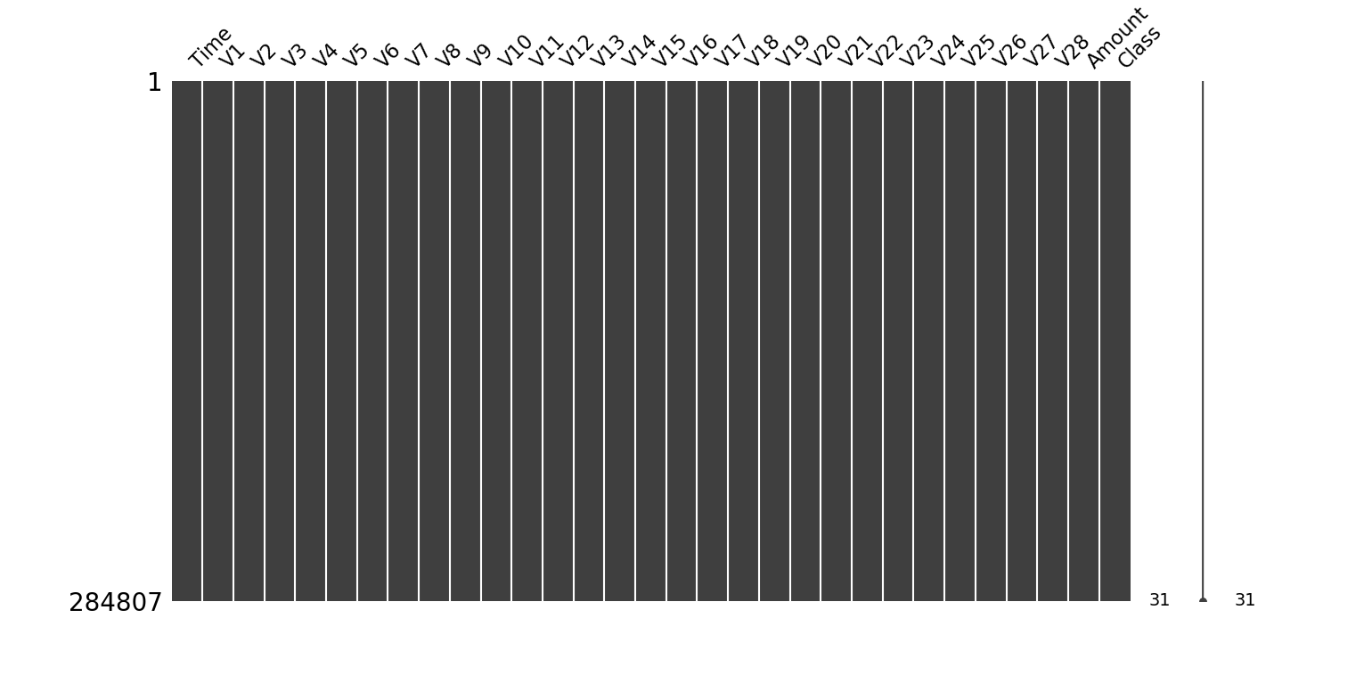
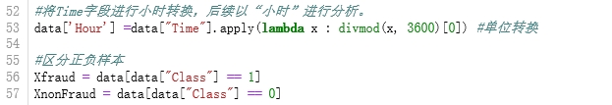
Data description and Preprocessing
Check of missing data
The whole dataset is integrated, there is no needs to impute missing values.
Bringing features onto the appropriate scale
Change the unit of Time to hour, instead of second.
Divide data set into two sample based on class.
In order to compare two samples.

Slide 7
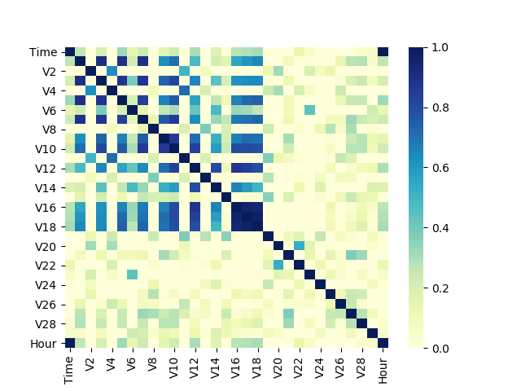
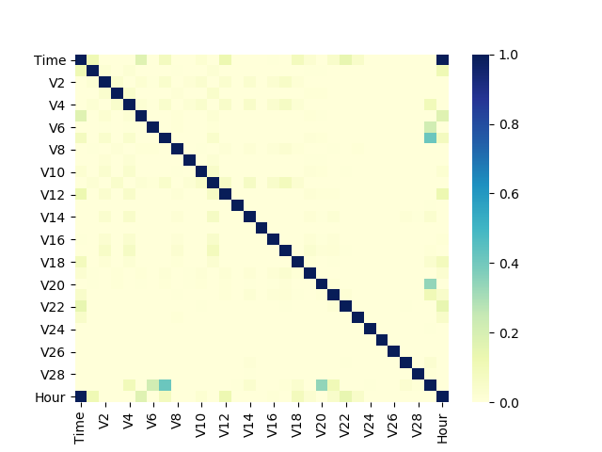
Looking at relations among variables
Contrast between two samples
In the event of credit card swiping, the correlation between some variables is more obvious. Among them, the variables V1, V2, V3, V4, V5, V6, V7, V9, V10, V11, V12, V14, V16, V17 and V18 show certain rule.
Relation description among variables of credit swiping sample
Relation description among variables without credit swiping cases

Slide 8
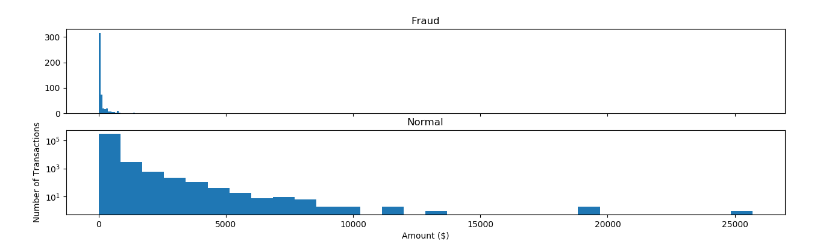
Amount of transaction
Compared with the amount of normal users, the amount of credit swiping is relatively small and scattered, which shows that the credit card robbers prefer to choose small amount consumption in order not to attract the attention of credit card owners.

Slide 9
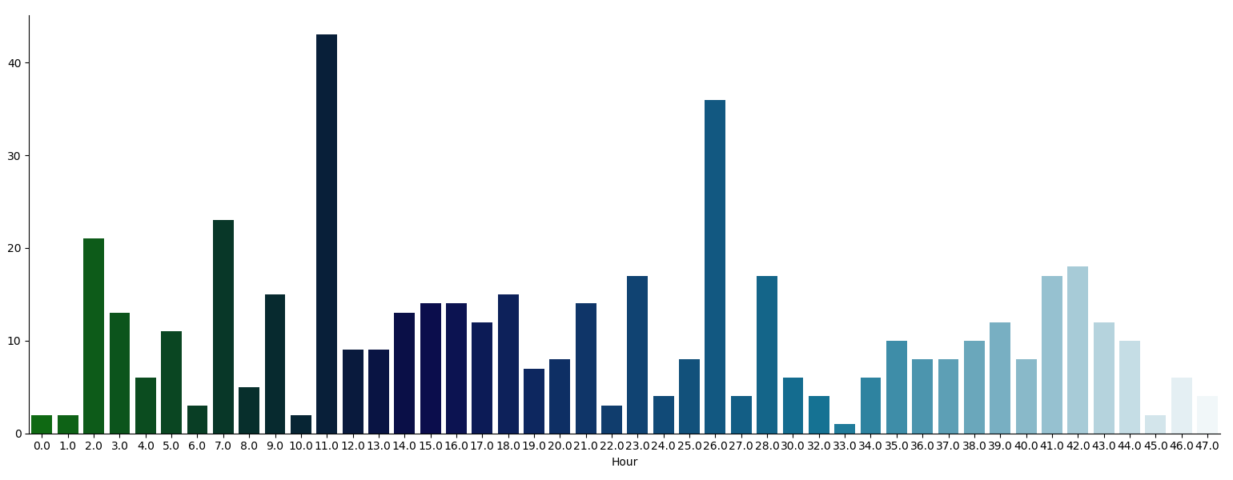
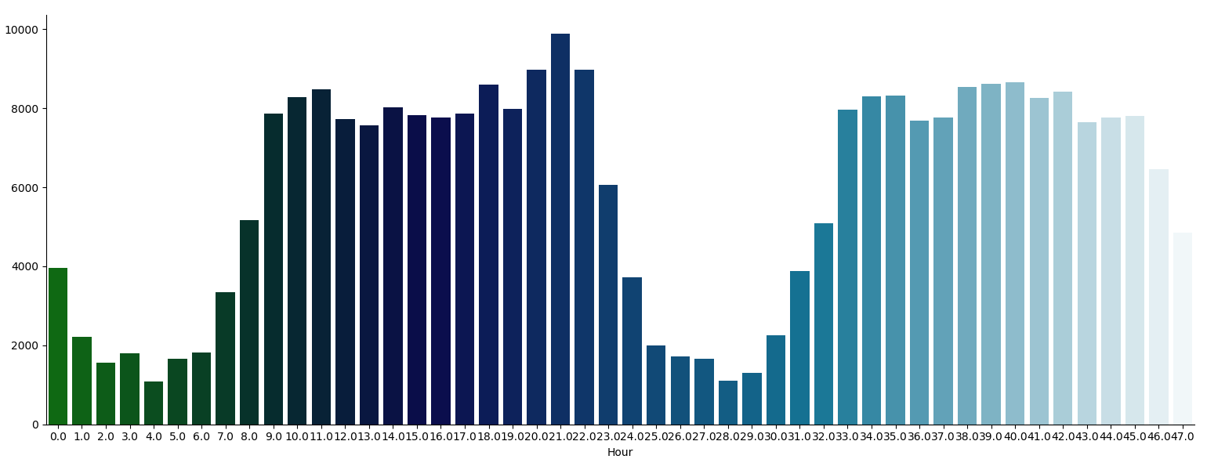
Time of transaction
Distribution of credit swiping
In order not to attract the attention of credit card owners, credit card thieves prefer to choose the time when the credit card owners sleep or during the time of high frequency consumption .
Distribution of normal transaction
Notes:
正常情况下大家哪个时间段最爱消费？
每天早上9点到晚上11点之间是信用卡消费的高频时间段。
盗刷：信用卡被盗刷数量案发最高峰在第一天上午11点达到43次，其次凌晨两点，说明信用卡盗刷者为了不引起信用卡卡主注意，更喜欢选择信用卡卡主睡觉时间和消费频率较高的时间点作案

Slide 10
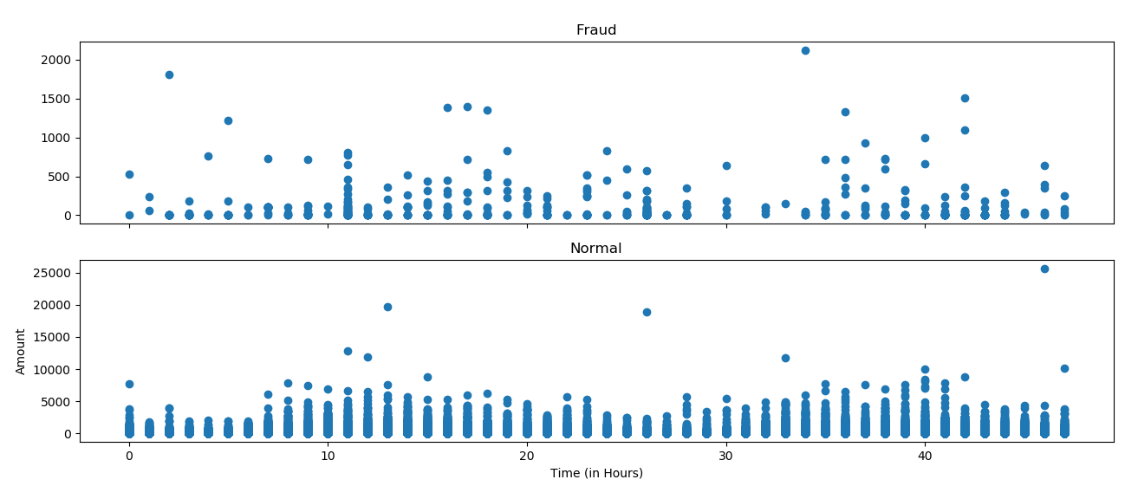
Relation between time and amount
The maximum value of credit card swiping is only 2125.87 US dollars
Notes:
结论一致，同时信用卡发生被盗刷的最大值也就只有2,125.87美元。

Slide 11
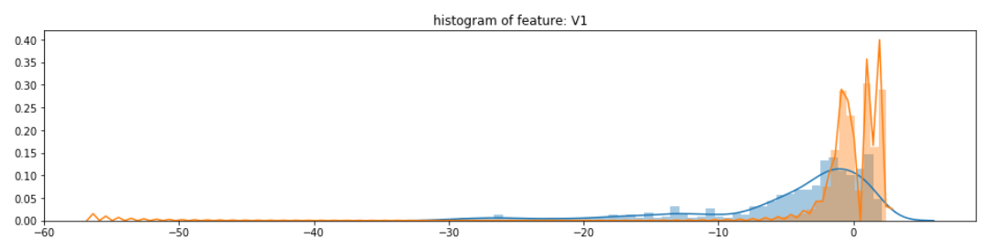
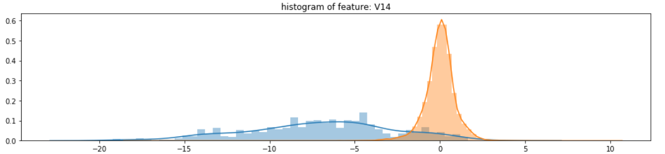
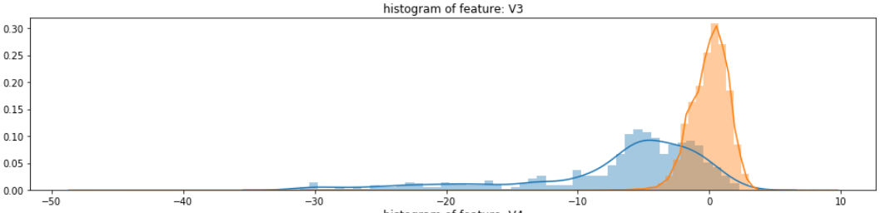
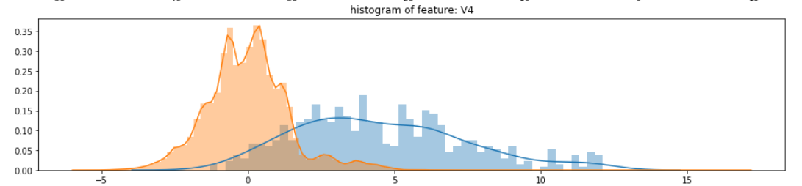
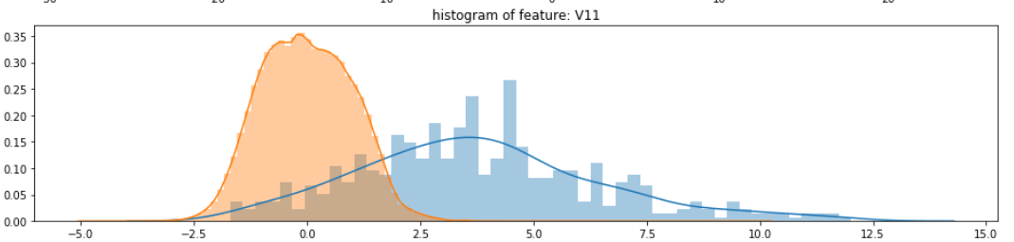
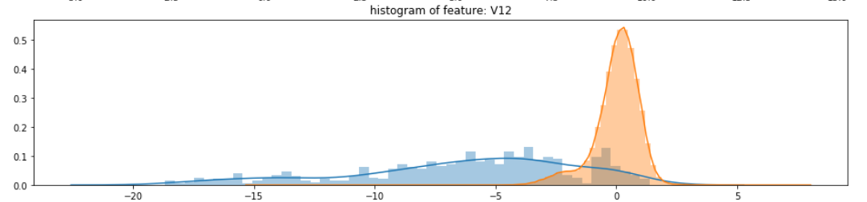
Visualization of the distribution
Retain the important variables
Notes:
选择在不同信用卡状态下的分布有明显区别的变量

Slide 12
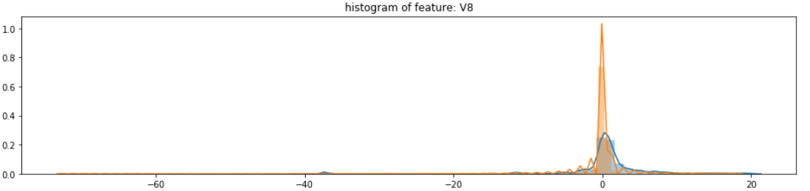
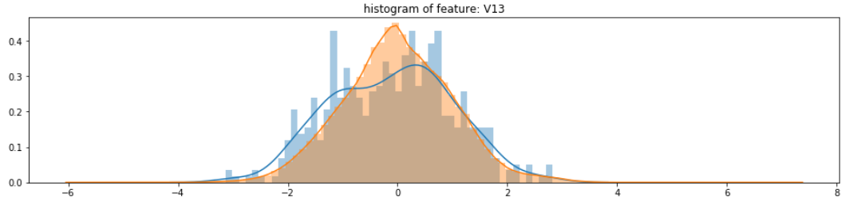
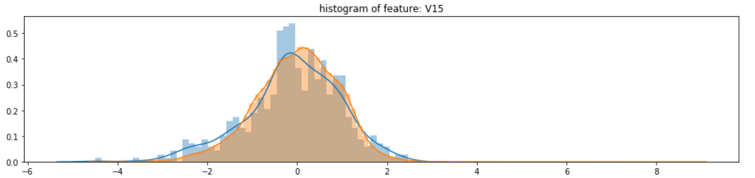
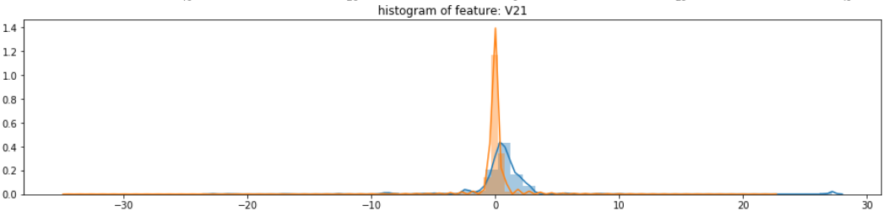
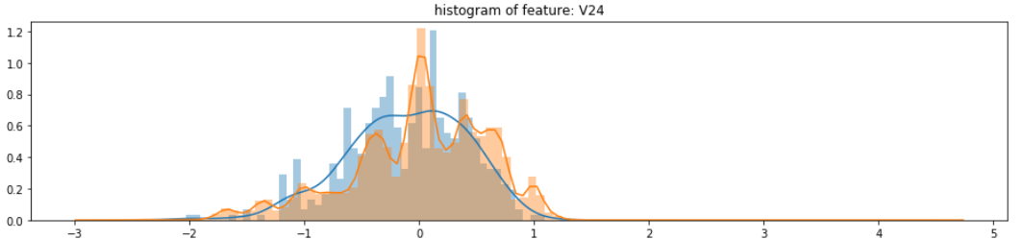
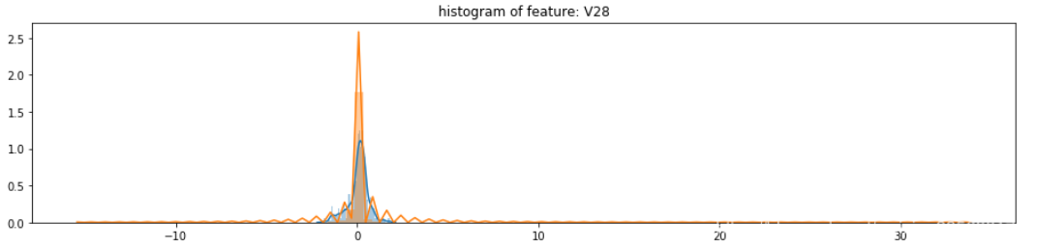
Visualization of the distribution
Removing relative meaningless variables

Slide 13
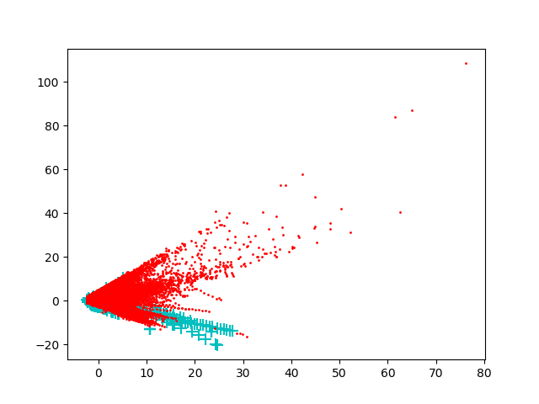
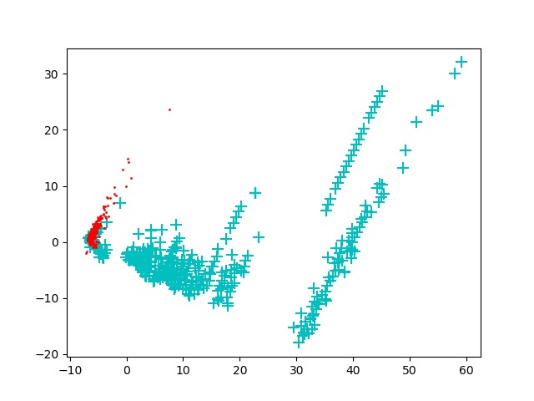
Dimensionality reduction via PCA
After collecting sample
When the amount of data is large, there exists serious class overlapping.
Notes:
由于特征Hour和Amount的规格和其他特征相差较大，因此我们先对其进行标准化
对数据进行主成分分析，降维到2维空间
不平衡 28万条非盗刷数据，数据量较大，盗刷数据只有不到500条
对非盗刷数据随机选取1000条，再进行主成分分析，区分效果变好了

Slide 14
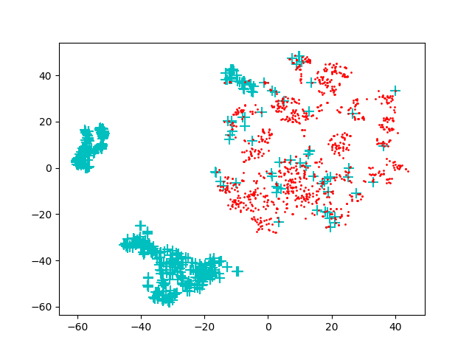
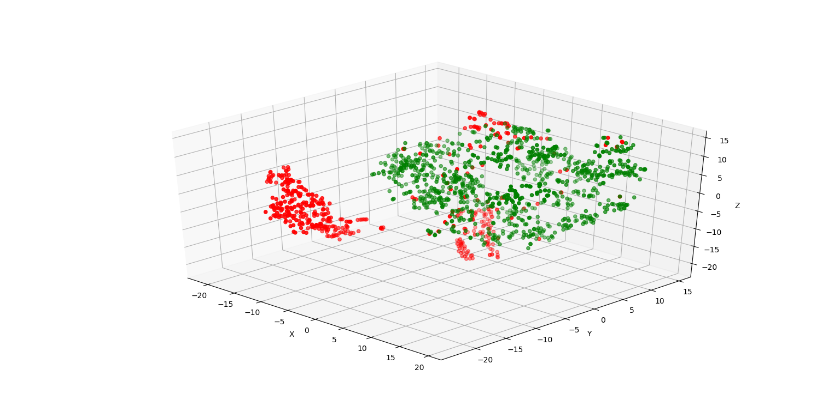
Dimensionality reduction via T-SNE
3D可视化
This method better differentiate the two sample.
Notes:
效果更好的非线性降维T-SNE, 正负样本区分更加明显
最后通过3d展示，可以更清晰地展示视觉上的效果

Slide 15
CONTENTS
Plague Flood
The Rat Clip
Rat Poison
Two-pronged

Slide 16
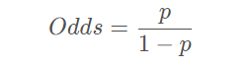
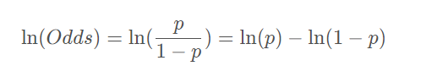
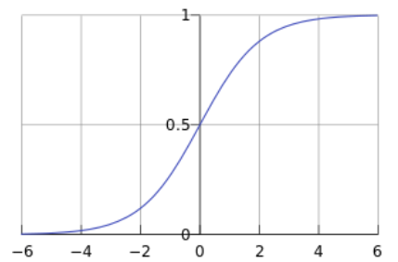
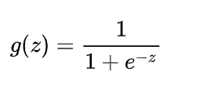
Logistic Regression
Logistic regression is a machine learning method used to solve binary classification (0 or 1) problems, used to estimate the likelihood of something. For example, the possibility of a user purchasing a product, the possibility of a patient suffering from a certain disease, and the possibility of an advertisement being clicked by the user.
The result of logistic regression is not a probability value in the mathematical definition, and cannot be used directly as a probability value. This result is often used for weighted summation with other eigenvalues rather than directly multiplying.
Odds:
The logit function is the natural logarithm of Odds, the definition domain is [0,1], and the value domain is R:
Sigmoid function is the inverse function of the above function

Slide 17
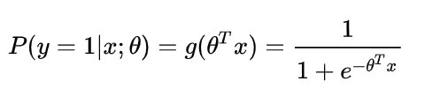
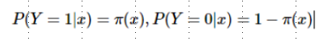
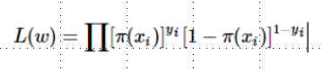
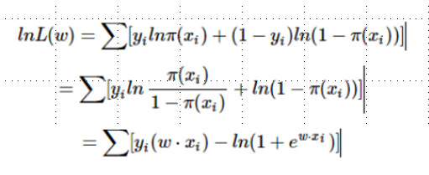
Logistic Regression
Conditional function form of logistic regression
Assuming
Likelihood function
Log-likelihood function
Logistic regression usually uses the gradient descent method and Newton method to find the extreme value
Notes:
一般选择0.5作为阈值。
参数估计

Slide 18
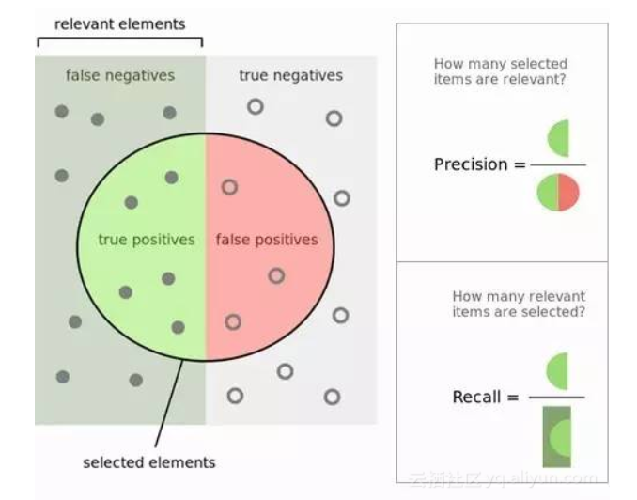
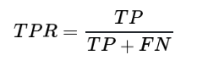
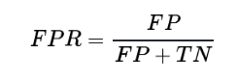
Logistic regression results and evaluation
Some important concepts:
True Positives, TP： The number of features predicted to be positive and actually positive
False Positives,FP： The number of features predicted to be positive and actually negative
True Negatives,TN： The number of features predicted to be negative and actually negative
False Negatives,FN： The number of features predicted to be negative and actually positive
Evaluation indicators:
precision = TP / （ TP + FP)
recall= TP / ( TP + FN）
F1 score = 2*precision * recall / (precision + recall )
true positive rate, TPR
false positive rate
Notes:
图如下所示，里面绿色的半圆就是TP(True Positives), 红色的半圆就是FP(False Positives), 左边的灰色长方形（不包括绿色半圆），就是FN（False Negatives）。右边的 浅灰色长方形（不包括红色半圆），就是TN(True Negatives)。这个绿色和红色组成的圆内代表我们分类得到模型结果认为是正值的样本。

Slide 19
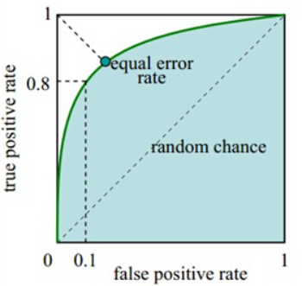
Logistic regression results and evaluation
ROC curve: receiver operating characteristic;
AUC(Area under Curve)：The area under the Roc curve is between 0.1 and 1. The larger the value, the better the result;
The AUC value is a probability value. When you randomly select a positive sample and a negative sample, the AUC value is the probability that this positive sample is in front of the negative sample by using current classification algorithm.
The larger the AUC value means that it is more likely to rank positive samples in front of negative samples, so that it can better classify.
Indicator | Value
accuracy | 1.00
roc_auc | 0.80
recall | 0.61
precision | 0.89
Result: the recall score is low, a large number of ‘1’ are misjudged as 0, and the prediction is biased towards ‘0’ because there are more ‘0’. The samples are extremely unbalanced.

Slide 20
How to fix sample imbalance
In the binary classification problem, the output categories of many models are based on thresholds. When the data is unbalanced, the model will output more data from big category;
In practical applications, the solutions include:
1) Adjust the classification threshold so that it prefers data with smaller categories;
2) Choose appropriate evaluation criteria, such as ROC instead of accuracy;
3）sampling: to deal with sample imbalance
Oversampling: Repeating positive data does not actually introduce more data into the model. Over-emphasizing positive data will amplify the impact of noise on the model.
Undersampling: Discard a large amount of data which may result in overfitting.
4）SMOTE（Synthetic Minority Oversampling Technique）: It is an improved scheme based on the random oversampling algorithm. The basic idea of the SMOTE algorithm is to analyze minority samples, and manually synthesize new samples based on the minority samples and add them to the data set to Balance the data set.

Slide 21
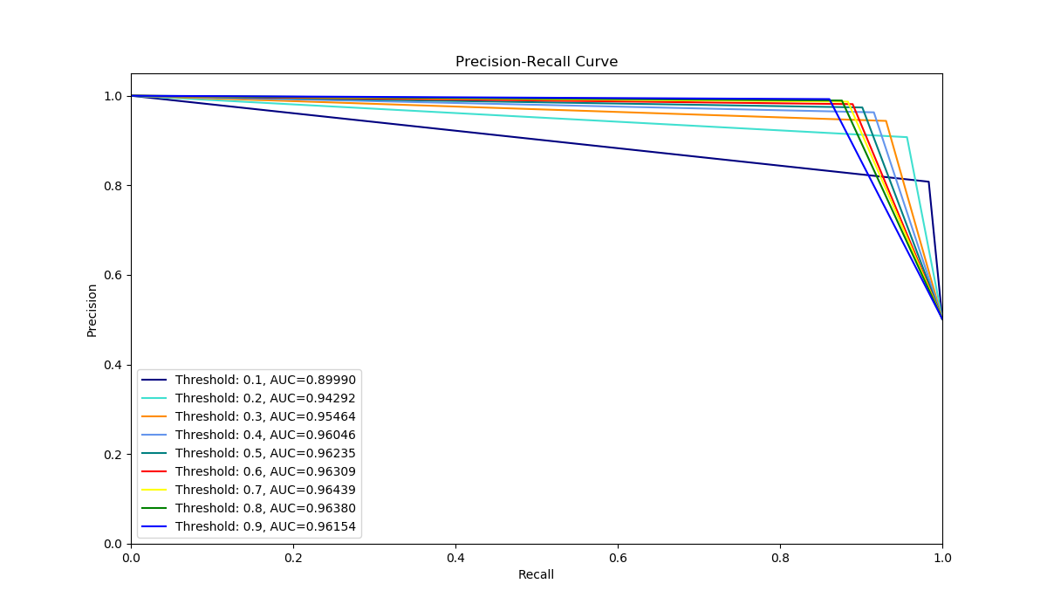
Result of oversampling +Logistic Regression
By using SMOTE oversampling we obtain 50% of positive and negative samples. Use the training set to train the logistic model and test the model by using test set:
Indicators | logistic | Oversampling +logistic
accuracy | 1.00 | 0.94
roc_auc | 0.80 | 0.94
recall | 0.61 | 0.90
precision | 0.89 | 0.97
 |  | Forecast result
 |  | Positive | Negative
Real result | Positive | 77,149 | 8,437
 | Negative | 2,073 | 82,930
Threshold and recall are a set of contradictory variables;
The smaller the precision, the larger the recall value, and the model can find more records of credit card stolen, but the price in exchange is that the number of false positives is also larger;
As the threshold increases, the recall value gradually decreases, the precision value gradually increases, and the number of misjudgments also decreases;
By adjusting the model threshold, the intensity of the model against credit card fraud is controlled;
Notes:
Insights: 实际业务中，阈值的选择取决于公司业务边际利润和边际成本的比较；当模型阈值设置较小的值， 确实能找出更多的信用卡被盗刷的持卡人，但随着误判数量增加，不仅加大了贷后团队的工作量， 也会降低误判为信用卡被盗刷客户的消费体验，从而导致客户满意度下降，如果某个模型阈值能 让业务的边际利润和边际成本达到平衡时，则该模型的阈值为最优值。当然也有例外的情况， 发生金融危机，往往伴随着贷款违约或信用卡被盗刷的几率会增大，而金融机构会更愿意不惜一切代价守住风险的底线。

Slide 22
CONTENTS
Plague Flood
The Rat Clip
Rat Poison
Two-pronged

Slide 23

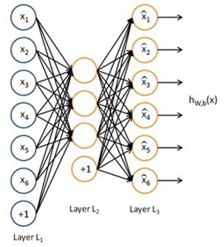
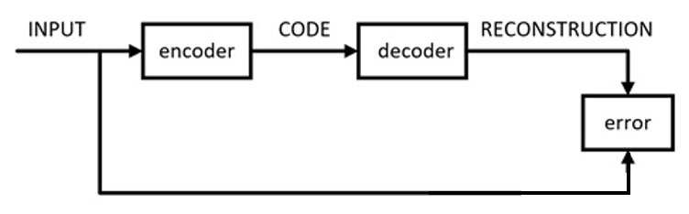
Introduction to AutoEncoder
AutoEncoder
Algorithm Concept
Autoencoder can be used for high-dimensional complex data processing. The auto-coding neural network is an unsupervised learning algorithm which uses the BP back propagation algorithm and makes the target value equal to the input value.
Autoencoder is used for dimensionality reduction or feature learning.
The number of neurons in the hidden layer of Autoencoder is less than the number of neurons in the output layer.
Autoencoder is a type of neural network. After training, it can try to copy the input to the output. Autoencoder learns an "identity function" with the same input and output.
The network structure of the autoencoder is very simple, including Input Layer, Hidden Layer and Output Layer. Among them, there is a hidden layer h inside the dynamic encoder, which can generate codes to represent the input. The network can be viewed as consisting of two parts: an encoder h = f (x) and a decoder for generating reconstruction r = g (h). Finally, make x approximately equal to g (f (x)). The network can be designed so that x = g (f (x)).

Slide 24
Considerations for Using AutoEncoder
The essence of the Autoencoder algorithm is: treat the hidden layer of the neural network as an encoder and decoder. The input data is encoded and decoded by the hidden layer. When it reaches the output layer, ensure that the output results are as consistent as possible with the input data. In practice, by imposing some constraints, the autoencoder can only be copied approximately, so it can learn the useful characteristics of the data.
1) The dimension of Hidden Layer is much smaller than the dimension of Input Layer;
2) Output is used to reconstruct Input, that is, to minimize the error L (Input, Output).
Because it is unlabeled data, the source of the error is obtained after reconstruction and compared with the input.
The Advantages of Autoencoder
The Disadvantages of Autoencoder
1） With dimensionality reduction effect, it can be used to extract main features ;
2） Can grasp the main features, so it has a certain anti-noise ability ;
3） Sparse has good interpretability, most of the real scenes satisfy this constraint ;
4） The algorithm is more robust ;
5） Strong expression ;
6） Strong expansion ability ;
7） Facilitate data visualization analysis .
1） It looks smart in theory, but it’s actually not very easy to use ;
2） Compression ability only applies to samples similar to training samples ;
3） The ability of encoder and decoder cannot be too strong.

Slide 25
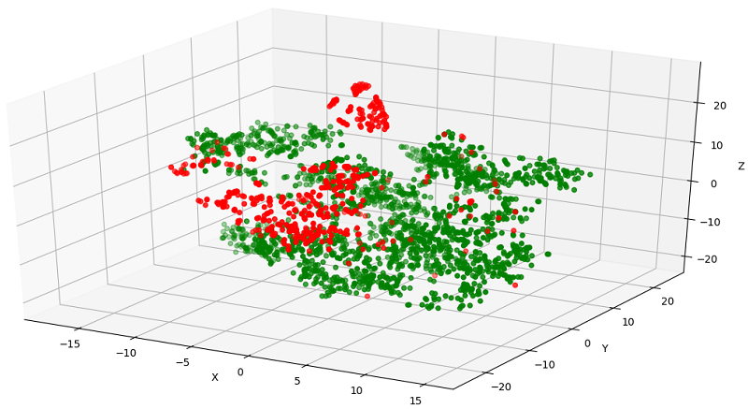
Feature Visualization
Data Visualization Results
TSNE
t-SNE is currently the most effective data dimensionality reduction and visualization method. When we want to classify high-dimensional data, it is not clear whether this data set has good separability, you can use t-SNE to project into a 2D or 3D space to observe. If it is separable in the low-dimensional space, the data is separable; if it is not separable in the high-dimensional space, it may be that the data is inseparable.
t-SNE (TSNE) converts the similarity between data points to probability. The similarity in the original space is represented by the Gaussian joint probability, and the similarity in the embedded space is represented by the "student t distribution".
Notes:
我们用TSNE将数据降维到3维，并进行可视化，结果显示，正负样例区分较明显。

Slide 26
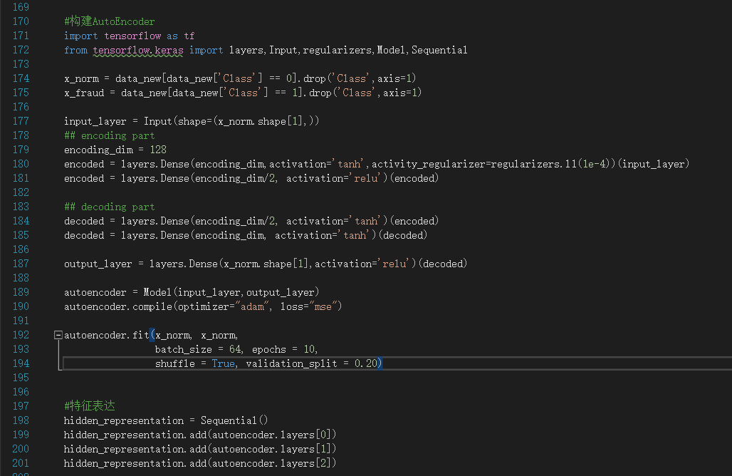
Building AutoEncoder

Slide 27
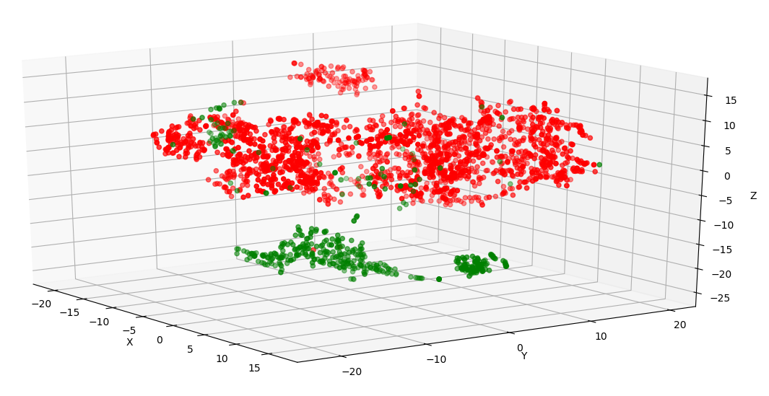
Visualization of Features after AutoEncoder Expression
Before AutoEncoder
After AutoEncoder
Notes:
对比看来，正负样本区分度略微提升

Slide 28
AutoEncoder+ LogisticRegression Result
Accuracy score: 0.99391407
Roc_auc score: 0.87153955
Recall score: 0.74324324
Precision score: 0.88709677
 | Precision | Recall | F1-Score | Support
0.0 | 1.00 | 1.00 | 1.00 | 85295
1.0 | 0.89 | 0.74 | 0.81 | 148
micro- avg | 1.00 | 1.00 | 1.00 | 85443
Macro avg | 0.94 | 0.87 | 0.90 | 85443
Weighted avg | 1.00 | 1.00 | 1.00 | 85443

Slide 29
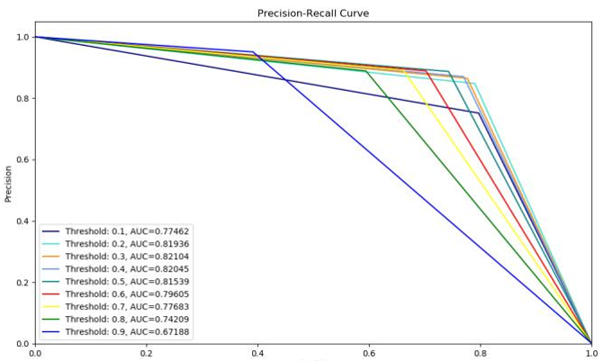
AutoEncoder+ LogisticRegression Result
The effect is significantly better than pure Logistic regression
Oversampling + Logistic regression
Autoencoder + Logistic regression

Slide 30
CONTENTS
Plague Flood
The Rat Clip
Rat Poison
Two-pronged

Slide 31
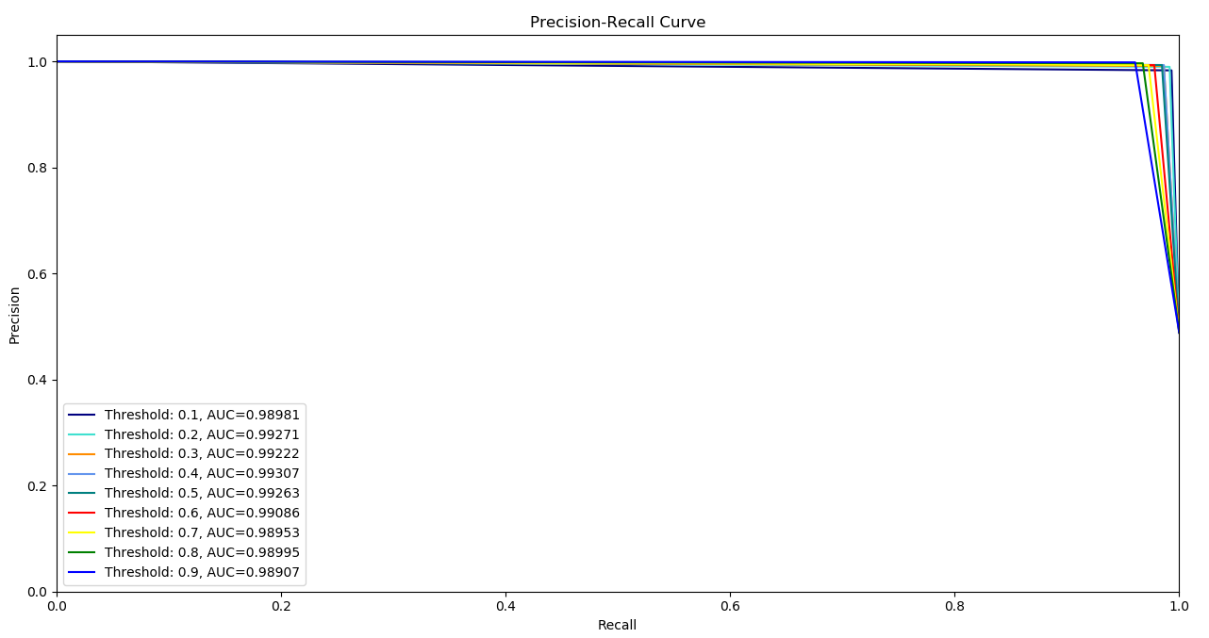
Ultra weapon —— Two-pronged
In order to better identify fraud, we use a two-pronged weapon.： （1）SMOTE Over-sampling（The Rat Clip） （2）AutoEncoder (Rat poison) （3）Logistic Regression
Performance score of our ultra weapon
 | Precision | Recall | F1-score | Support
0.0 | 0.99 | 0.99 | 0.99 | 614
1.0 | 0.99 | 0.99 | 0.99 | 586
Micro Avg | 0.99 | 0.99 | 0.99 | 1200
Macro Avg | 0.99 | 0.99 | 0.99 | 1200
Weighted Avg | 0.99 | 0.99 | 0.99 | 1200

Slide 32
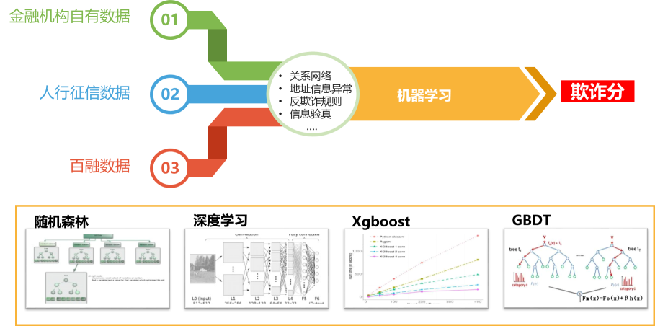
Anti-fraud Machine Learning model - Supervised learning
Data in Financial institution
Models
Credit Investigation data in PBC
Machine Learning
Fraud score
Behavior Data in Internet companies
Random Forest
Deep Learning
Xgboost
GBDT

Slide 33
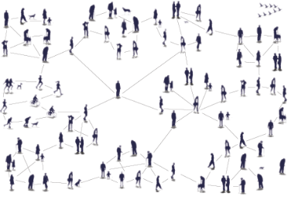
Anti-fraud Machine Learning model - Unsupervised learning
Relational network
How to recognize fraud
Aristotle put forward that "man is a social animal". A relatively stable system of relationships formed between social individuals due to interaction. Relational networks focus on the interactions and connections between people.
Social relationships include friends, classmates, business partners, race and faith, teachers and students, etc. Through these social relationships, various people or organizations from casual acquaintance to close family ties are connected.
Relational network is a graph-based data structure consisting of nodes and edges. Each node represents an individual, and each edge represents the relationship between individuals. By connecting different individuals to their relationships, relational networks provide the ability to analyze problems from a "relational" perspective, which allows us to identify abnormal gang fraud from normal behavior.
Find points or groups in the data that have abnormal properties. If a node is closely related to many other nodes, and the relationship is more than two degrees, and there are several nodes in the network with fraud suspicion, then the group of this network can be regarded as abnormal.

Slide 34


